Slide 1






Current State Challenges
Challenges
Slow Execution
Manual Driver Management
High Test Flakiness
Selenium's reliance on the WebDriver protocol introduces latency, resulting in test runs that are 30-40% slower than modern alternatives like Playwright.
Requires manual setup and maintenance of browser drivers, increasing infrastructure complexity and ongoing operational overhead.
Manual wait handling leads to intermittent test failures, causing a flakiness rate of 8-12% that disrupts continuous delivery.
Complex TestNG XML
Steep Learning Curve
Fragmented Debugging Tools
Intricate and verbose TestNG XML files complicate test suite management, slowing down scalability and maintainability.
Selenium’s setup and API complexity require significant developer ramp-up time, reducing developer velocity.
Limited debugging capabilities and lack of integrated trace viewers make diagnosing failures time-consuming.

Slide 2
The Playwright Advantage
Advantage
Selenium Architecture
Playwright Architecture
Auto-Waiting Mechanism
Trace Viewer
Selenium tests communicate through a Client -> WebDriver -> Browser HTTP middleman layer, which introduces latency and complexity in browser control.
Playwright communicates directly with the browser using the DevTools Protocol, enabling faster, more reliable interactions without intermediary layers.
Playwright’s built-in auto-waiting automatically handles element readiness before actions, reducing flaky tests caused by timing issues prevalent in Selenium.
Playwright offers a Trace Viewer tool that records and visualizes test execution details, aiding in efficient debugging and performance optimization.
Diagram of Client -> WebDriver -> Browser path
Highlight HTTP communication overhead
Manual driver management
Diagram of Client <-> Browser direct communication
Elimination of HTTP layer
Simplified browser control
Auto-waiting feature explanation
Reduction in manual wait code
Improved test stability
Trace Viewer screenshots
Debugging insights
Performance bottleneck identification

Slide 3
Migration Workflow
Migration
Audit & Setup
Page Object Refactoring
Test Logic Conversion
CI/CD & Parallelization
Assess existing Selenium tests and set up Playwright environment with dependencies and browser auto-installation.
Refactor Page Object Models from Java to Python using Playwright’s simpler API for better maintainability.
Translate Selenium TestNG test cases to Playwright Python scripts with auto-waiting and debugging features.
Integrate Playwright tests into CI/CD pipelines enabling parallel execution and automated reporting.
Test suite inventory
Configured Playwright environment
Installed dependencies & browsers
Baseline metrics
Converted Page Objects in Python
Code review & validation
Updated documentation
Reusable components
Converted test scripts
Auto-wait integration
Debugging & trace setup
Initial test reports
CI/CD configured with Playwright
Parallel test execution
Automated reporting
Performance dashboards

Slide 4
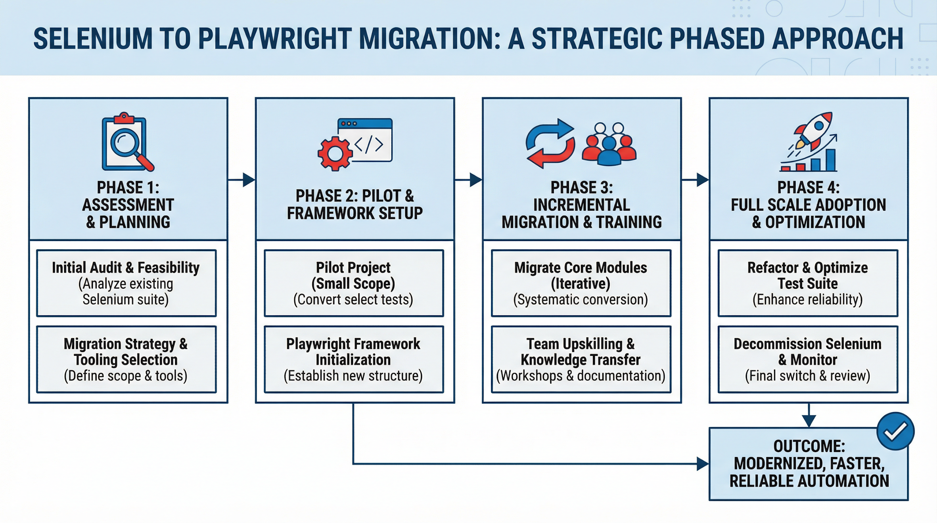
Migration Journey Overview

Slide 5
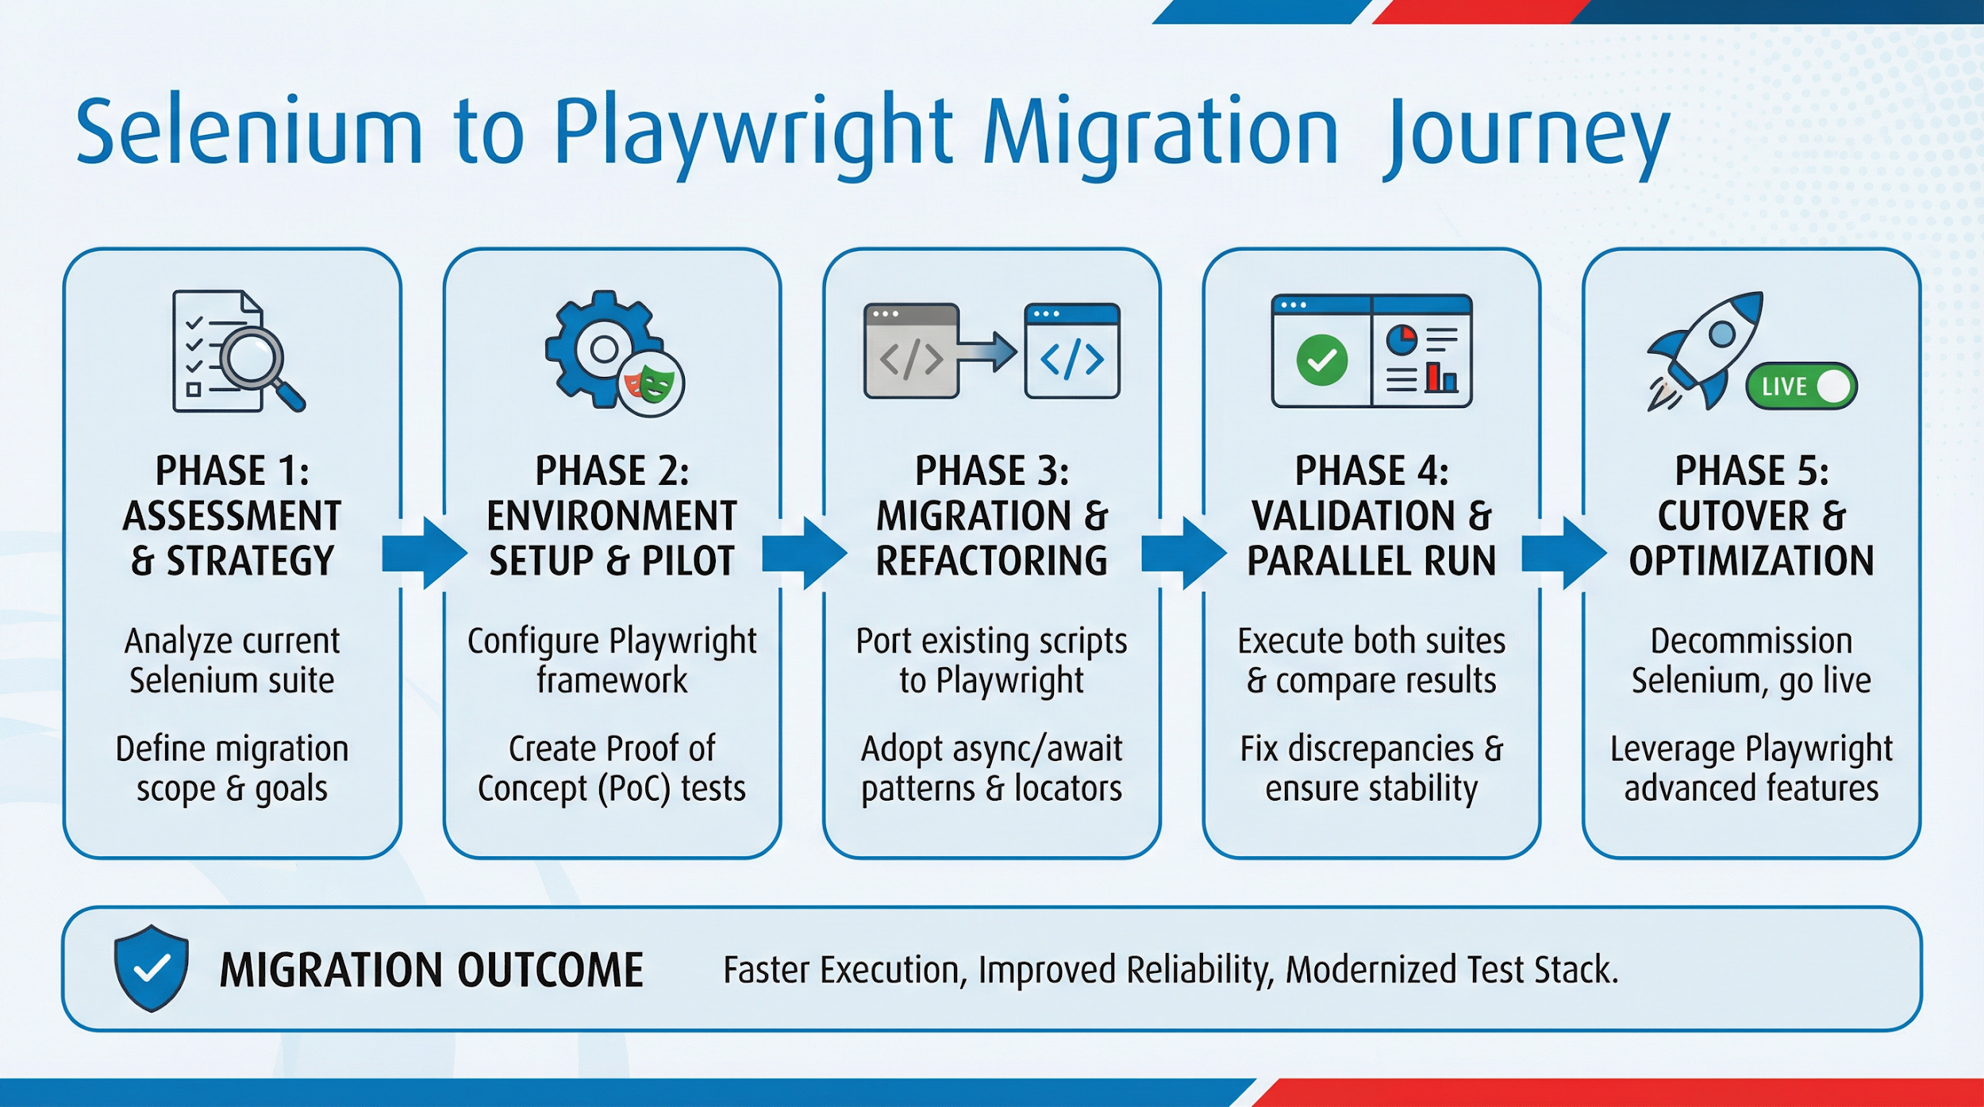

Slide 6
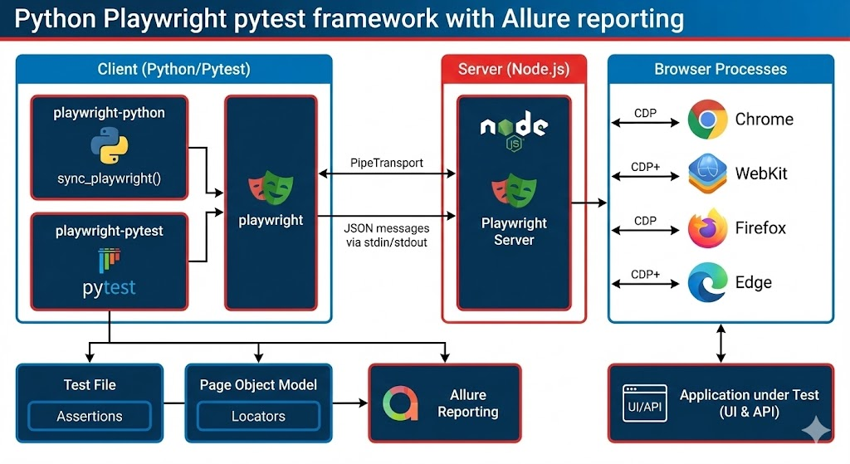

Slide 7
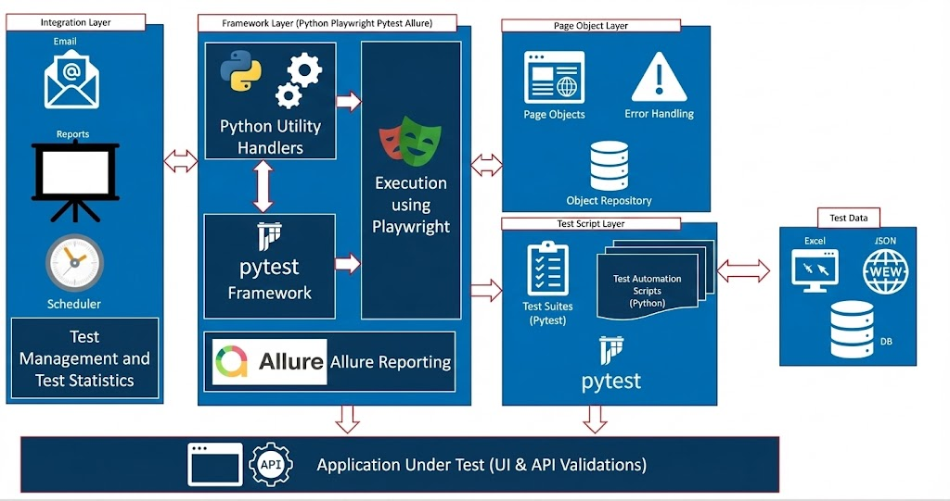

Slide 8
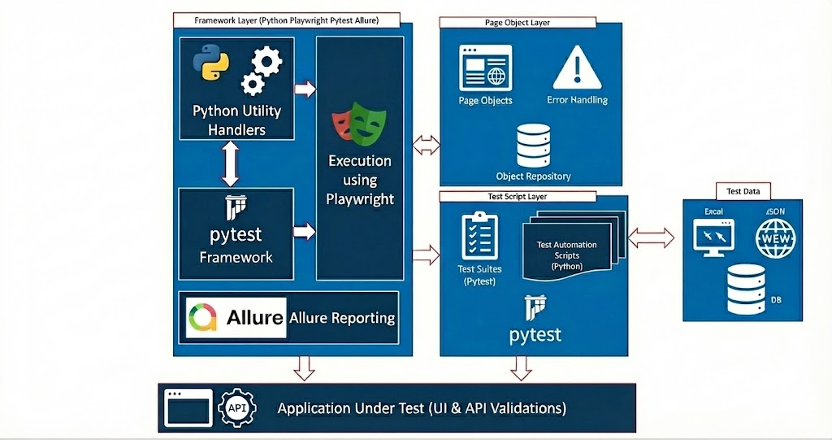
Playwright Framework Architecture
Playwright Client (Python): Python scripts utilize Playwright API for browser automation and testing.
Driver Layer: Converts Python commands into browser-specific protocols, ensuring smooth communication.
Browser Engines: Supports Chromium, Firefox, and WebKit for comprehensive cross-browser testing.
Browser Contexts & Pages: Enables isolated sessions and tabs for parallel, independent test execution.
Communication Protocols: Uses WebSocket or Chrome DevTools Protocol (CDP) for real-time browser interaction.
Test Execution: Executes tests on headless or headed browsers based on configuration.
Event Handling & Logging: Captures browser events, logs, and errors to aid debugging and analysis.
Pytest Integration: Leverages pytest framework for test organization, fixtures, and execution control.
Allure Reports: Generates detailed and visually rich test reports for comprehensive result analysis.
Zephyr Integration: Connects test results with Zephyr for test management and traceability in agile workflows.

Slide 9
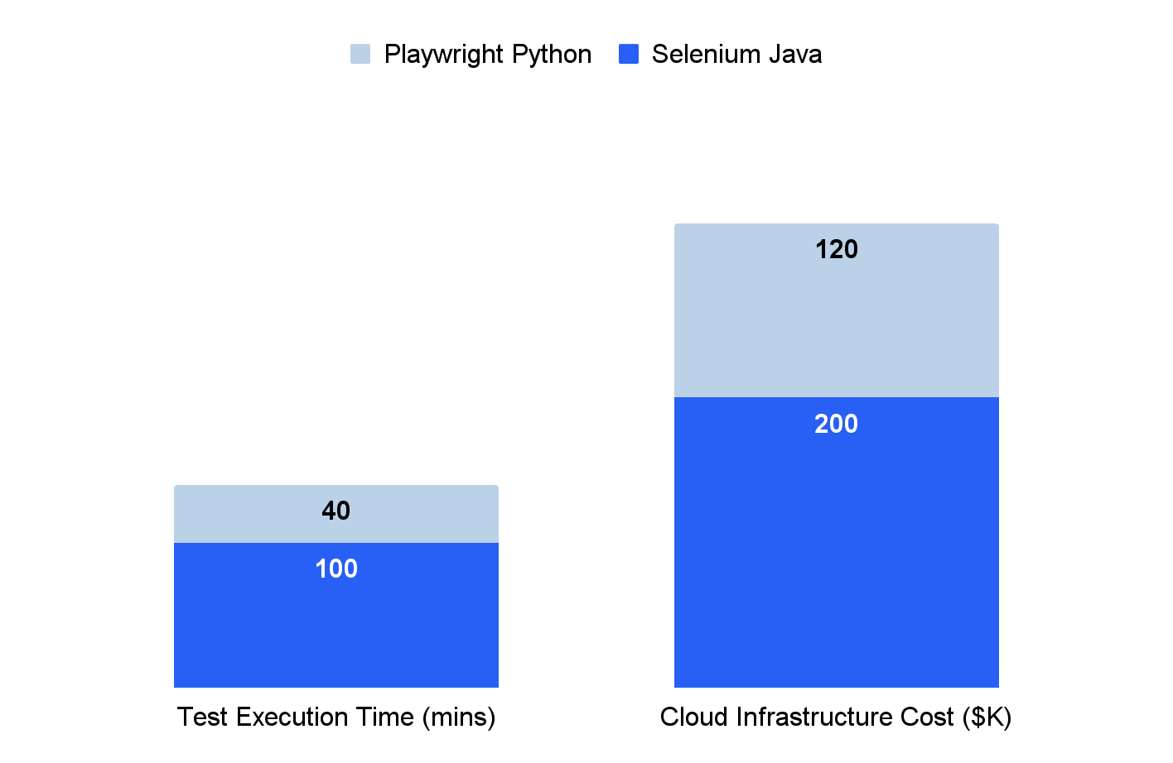
Financial & Operational ROI
ROI
Execution Time and Infrastructure Cost Savings
Key Operational Benefits
60% faster test execution reduces overall QA cycle time, accelerating release velocity.
Lower cloud and CI/CD costs due to reduced test runtime and more efficient parallelization.
Improved developer velocity as faster feedback loops enable quicker debugging and feature delivery.
Reduced test flakiness decreases maintenance overhead and increases confidence in automated tests.

Slide 10
Pilot
Playwright API Sanity
Exploring
SteadyState

